Slide 1
EE-353 Computer Networks
Bilal Rauf
Introduction

Slide 2
Chapter 1: roadmap
  1.1 What is the Internet?
  1.2 Network edge
    end systems, access networks, links
  1.3 Network core
    circuit switching, packet switching, network structure
  1.4 Delay, loss and throughput in packet-switched networks
  1.5 Protocol layers, service models
  1.6 Networks under attack: security
  1.7 History
Introduction
1-<number>

Slide 3

The Network Core
Mesh of interconnected routers
The fundamental question: how is data transferred through net?
  Circuit switching: The resources needed along a path to provide for communication between the end system are reserved for the duration of communication session.
  Packet-switching: The resources are not reserved; a session messages use the resources on demand and may have to wait in queue for the access of communication link.
Introduction
1-<number>

Slide 4




Network Core: Circuit Switching
End-end resources reserved for “call”
A bona fide connection for which the switches on the path between the sender and receiver maintain connection state for that connection.
This connection is called circuit.
Circuit maintain constant transmission rate in the network’s link for the duration of the connection.
Each of the link in circuit switching has n circuits, so each link can support n simultaneous connections.
switch capacity
dedicated resources: no sharing
circuit-like (guaranteed) performance
call setup required
Introduction
1-<number>

Slide 5
Network Core: Circuit Switching
A dedicated end-to-end connection between two hosts.
The circuit in a link is implemented with either
  Frequency division multiplexing (FDM)
  Time division multiplexing (TDM)
FDM
In FDM, the frequency spectrum of a link is divided up among the connections established across the link.
The frequency band in telephone network has a width of 4 kHz.
TDM
In TDM link, time is divided into frames of fixed duration and each frame is divided into fixed number of time slots.
when network establish a connection across a link, the network dedicates one time slot in every frame to this connection.
Introduction
1-<number>

Slide 6
Circuit Switching: FDM and TDM
Example:
FDM
4 users
frequency
time
TDM
frequency
time
Introduction
1-<number>
Notes:
Two simple multiple access control techniques.
Each mobile’s share of the bandwidth is divided into portions for the uplink and the downlink. Also, possibly, out of band signaling.
As we will see, used in AMPS, GSM, IS-54/136

Slide 7
Network Core: Packet Switching
In packet switching, the packet is sent into the network without reserving any bandwidth.
resource contention:
aggregate resource demand can exceed amount available
congestion: packets queue, wait for link use
store and forward: packets move one hop at a time
  Node receives complete packet before forwarding
Each end-end data stream divided into packets
user A, B packets share network resources
each packet uses full link bandwidth
resources used as needed
Introduction
1-<number>

Slide 8
Packet Switching: Statistical Multiplexing
100 Mb/s
Ethernet
A
C
statistical multiplexing
1.5 Mb/s
B
queue of packets
waiting for output
link
D
E
Sequence of A & B packets does not have fixed pattern, bandwidth shared on demand.
TDM: each host gets same slot in revolving TDM frame.
Introduction
1-<number>

Slide 9
Packet-switching: store-and-forward
L
R
R
R
takes L/R seconds to transmit (push out) packet of L bits on to link at rate R bps
store and forward: entire packet must arrive at router before it can be transmitted on next link
delay = 3L/R (assuming zero propagation delay)
Example:
L = 7.5 Mbits
R = 1.5 Mbps
transmission delay = 15 sec
Introduction
1-<number>

Slide 10
How do Packet Make Their Way Through Packet-Switched Network?
How a router takes a packet arriving on one of its attached communication links and forward that packet on to another of its attached communication links?
Each packet traversing the network contains the address of the packets destination in its header.
At the arrival of the packet, the router examines the destination address and forward the packet to an adjacent router.
Each router has a forwarding table that maps destination address to outbound links.
Forwarding table is created/updated automatically by the routing algorithms/ protocols.
Introduction
1-<number>

Slide 11
ISPs and Internet Backbones
At the very top of the hierarchy is a relatively small number of so called Tier-1 ISP as known as internet Backbone e.g. AT&T, Sprint, Qwest etc.
Tier-1 ISP are special and their link speeds are often 622Mbps or higher.
The larger Tier-1 ISP have links in the 2.5 to 10 Gbps range.
Router of Tier-1 ISP must be able to forward packets at extremely higher rates.
Tier-1 ISP are also categorized by
Directly connected to each other Tier-1 ISP.
Connected to large number of Tier-2 ISP and customer networks.
International in coverage
Tier 1 ISP
Tier 1 ISP
Tier 1 ISP
Introduction
1-<number>

Slide 12
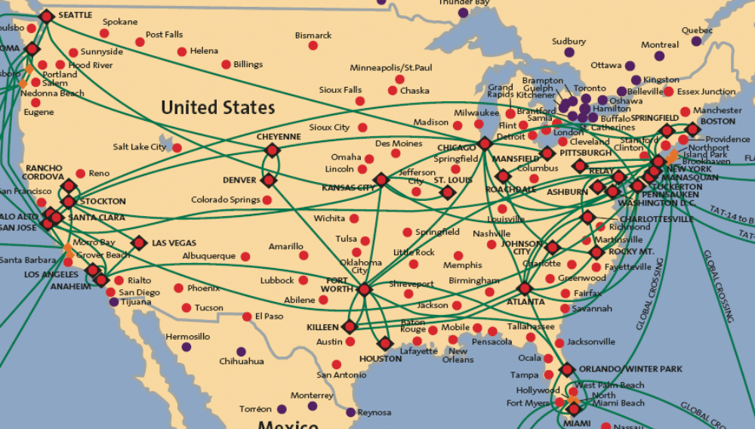
Tier-1 ISP: e.g., Sprint
Introduction
1-<number>

Slide 13
ISPs and Internet Backbones
“Tier-2” ISPs: smaller (often regional) ISPs
  Connect to one or more tier-1 ISPs, possibly other tier-2 ISPs
In order to reach a large portion of the global internet , a Tier-2 ISP needs to route traffic through one of the Tier-1 ISPs to which it is connected.
Tier-2 ISPs also peer privately with each other.
Tier-2 ISP pays tier-1 ISP for connectivity to rest of Internet
tier-2 ISP is customer of
tier-1 provider
Tier-2 ISP
Tier-2 ISP
Tier 1 ISP
Tier 1 ISP
Tier 1 ISP
Tier-2 ISP
Tier-2 ISP
Tier-2 ISP
Introduction
1-<number>

Slide 14
Internet structure: network of networks
“Tier-3” ISPs and local ISPs
  last hop (“access”) network (closest to end systems)
local
ISP
Tier 3
ISP
local
ISP
local
ISP
local
ISP
Local and tier- 3 ISPs are customers of
higher tier ISPs
connecting them to rest of Internet
Tier-2 ISP
Tier-2 ISP
Tier 1 ISP
Tier 1 ISP
Tier 1 ISP
Tier-2 ISP
Tier-2 ISP
Tier-2 ISP
local
ISP
local
ISP
local
ISP
local
ISP
Introduction
1-<number>

Slide 15
Internet structure: network of networks
a packet passes through many networks!
local
ISP
Tier 3
ISP
local
ISP
local
ISP
local
ISP
Tier-2 ISP
Tier-2 ISP
Tier 1 ISP
Tier 1 ISP
Tier 1 ISP
Tier-2 ISP
Tier-2 ISP
Tier-2 ISP
local
ISP
local
ISP
local
ISP
local
ISP
Introduction
1-<number>

Slide 16
Chapter 1: roadmap
  1.1 What is the Internet?
  1.2 Network edge
    end systems, access networks, links
  1.3 Network core
    circuit switching, packet switching, network structure
  1.4 Delay, loss and throughput in packet-switched networks
  1.5 Protocol layers, service models
Introduction
1-<number>

Slide 17
Delay, Loss and Throughput in Packet-switched Network
As packet moves from one node to another along the path, suffers from several types of delay a each node along the path.
The most important delays are Nodal Processing Delay, Queuing delay, Transmission delay and Propagation Delay.
These delay accumulate to give Total Nodal Delay.
packets queue in router buffers
packet arrival rate to link exceeds output link capacity
packets queue, wait for turn
packet being transmitted (delay)
A
B
packets queueing (delay)
free (available) buffers: arriving packets
dropped (loss) if no free buffers
Introduction
1-<number>

Slide 18
Four sources of packet delay
1. Nodal Processing Delay:
  check bit errors
  determine output link
  The time req to examine the packet header and determine where to direct the packet is part of processing delay
  This delay is very less in high speed routers i.e. in microseconds or less.
2. Queuing Delay
  time waiting at output link for transmission
  depends on congestion level of router
  Delay can be in microseconds or milliseconds.
transmission
A
propagation
B
nodal
processing
queueing
Introduction
1-<number>

Slide 19
Delay in packet-switched networks
3. Transmission delay:
This is the amount of time required to push all the packet’s bits into the link.
R=link bandwidth (bps)
L=packet length (bits)
time to send bits into link = L/R
4. Propagation delay:
d = length of physical link
s = propagation speed in medium 2x10⁸ m/sec to 3x10⁸ m/sec
propagation delay = d/s
Note: s and R are very different quantities!
transmission
A
propagation
B
nodal
processing
queueing
Introduction
1-<number>

Slide 20
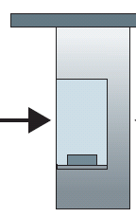

Comparing Transmission and Propogation Delay
100 km
100 km
ten-car
caravan
toll
booth
toll
booth
cars “propagate” at
100 km/hr
toll booth takes 12 sec to service car (transmission time)
car~bit; caravan ~ packet
Q: How long until caravan is lined up before 2nd toll booth?
Time to “push” entire caravan through toll booth onto highway = 12*10 = 120 sec
Time for last car to propagate from 1st to 2nd toll both: 100km/(100km/hr)= 1 hr
A: 62 minutes
Introduction
1-<number>

Slide 21
Caravan analogy (more)
100 km
100 km
ten-car
caravan
toll
booth
toll
booth
Yes! After 7 min, 1st car at 2nd booth and 3 cars still at 1st booth.
1st bit of packet can arrive at 2nd router before packet is fully transmitted at 1st router!
Cars now “propagate” at
1000 km/hr
Toll booth now takes 1 min to service a car
Q: Will cars arrive to 2nd booth before all cars serviced at 1st booth?
Introduction
1-<number>

Slide 22
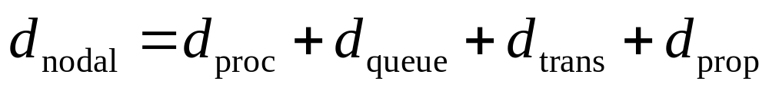
Nodal delay
d_{proc} = processing delay
  typically a few microsecs or less
d_{queue} = queuing delay
  depends on congestion
d_{trans} = transmission delay
  = L/R, significant for low-speed links
d_{prop} = propagation delay
  a few microsecs to hundreds of msecs
Introduction
1-<number>

Slide 23
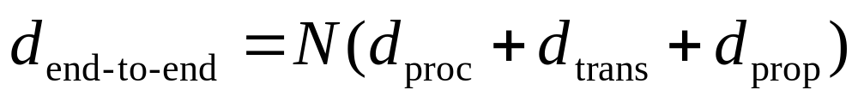
End-to-End Delay
Total Nodal delay is the delay at a single router.
The total end to end delay is
Here we have consider uncongested network. So queuing delay is negligible.
Also, N is the number of routers between source and destination.
Introduction
1-<number>

Slide 24
Throughput
In addition to delay and packet loss, another critical performance measure in computer network is end-to-end throughput.
throughput: rate (bits/time unit) at which bits transferred between sender/receiver
  instantaneous: rate at given point in time
  average: rate over longer period of time
link capacity
R_{s} bits/sec
link capacity
R_{c} bits/sec
server, with
file of F bits
to send to client
pipe that can carry
fluid at rate
R_{s} bits/sec)
pipe that can carry
fluid at rate
R_{c} bits/sec)
server sends bits
(fluid) into pipe
Introduction
1-<number>

Slide 25
Throughput (more)
R_{s} < R_{c} What is average end-end throughput?
R_{s} bits/sec
R_{c} bits/sec
R_{s} > R_{c} What is average end-end throughput?
R_{s} bits/sec
R_{c} bits/sec
bottleneck link
link on end-end path that constrains end-end throughput
Introduction
1-<number>

Slide 26
Throughput: Internet scenario
R_{s}
per-connection end-end throughput: min(R_{c},R_{s},R/10)
in practice: R_{c} or R_{s} is often bottleneck
R_{s}
R_{s}
R
R_{c}
R_{c}
R_{c}
10 connections (fairly) share backbone bottleneck link R bits/sec
Introduction
1-<number>

Slide 27
Chapter 1: roadmap
  1.1 What is the Internet?
  1.2 Network edge
    end systems, access networks, links
  1.3 Network core
    circuit switching, packet switching, network structure
  1.4 Delay, loss and throughput in packet-switched networks
  1.5 Protocol layers, service models
Introduction
1-<number>

Slide 28
Protocol “Layers”
Networks are complex!
many “pieces”:
  hosts
  routers
  links of various media
  applications
  protocols
  hardware, software
Question:
Is there any hope of organizing structure of network?
Introduction
1-<number>

Slide 29
Organization of air travel
ticket (purchase)
baggage (check)
gates (load)
runway takeoff
airplane routing
ticket (complain)
baggage (claim)
gates (unload)
runway landing
airplane routing
airplane routing
a series of steps
Introduction
1-<number>

Slide 30

Layering of airline functionality
ticket (purchase)
baggage (check)
gates (load)
runway (takeoff)
airplane routing
ticket (complain)
baggage (claim
gates (unload)
runway (land)
airplane routing
ticket
baggage
gate
takeoff/landing
airplane routing
airplane routing
airplane routing
departure
airport
intermediate air-traffic
control centers
arrival
airport
Layers: each layer implements a service
  via its own internal-layer actions
  relying on services provided by layer below
Introduction
1-<number>

Slide 31
Why layering?
To provide structure to the design of network protocols, network designers organize protocols and the network hardware and software that implement the protocol in Layers.
A protocol layer can be implemented in software, in hardware or in a combination of the two.
  Application layer protocols such as HTTP, DNS, SMTP are always implemented in software at the end system. Protocols in Transport layer are also software based.
  Physical and Data link layer are responsible for handling communication over a specific link, they are typically implemented in network interface card associated with a link.
  The Network Layer is often a mixed implementation of hardware and software.
Advantages of layering
  Provides structure way to discuss system components.
  Modularity makes it easier to update system components.
Introduction
1-<number>

Slide 32
Internet protocol stack or
TCP/IP model
application: supporting network applications
  FTP, SMTP, HTTP
transport: process-process data transfer
  TCP, UDP
network: routing of datagrams from source to destination
  IP, routing protocols
link: data transfer between neighboring network elements
  PPP, Ethernet
physical: bits “on the wire”
application
transport
network
link
physical
Introduction
1-<number>

Slide 33
ISO/OSI reference model
presentation: allow applications to interpret meaning of data, e.g., encryption, compression, machine-specific conventions
session: synchronization, checkpointing, recovery of data exchange
Internet stack “missing” these layers!
  these services, if needed, must be implemented in application
  needed?
application
presentation
session
transport
network
link
physical
Introduction
1-<number>

Slide 34
Difference between TCP/IP and OSI Models
The main differences between the two models are as follows:
OSI is a reference model and TCP/IP is an implementation of OSI model.
TCP/IP Protocols are considered to be standards around which the internethas developed. The OSI model however is a"generic, protocol-independent standard.“
TCP/IP combines the presentation and session layer issues into itsapplication layer.
TCP/IP combines the OSI data link and physical layers into the network access layer.
TCP/IP appears to be a simpler model and this is mainly due to the fact thatit has fewer layers.
TCP/IP is considered to be a more credible model- This is mainly due to thefact because TCP/IP protocols are the standards around which the internetwas developed therefore it mainly gains creditability due to thisreason. Where as in contrast networks are not usually built around the OSImodel as it is merely used as a guidance tool.
The OSI model consists of 7 architectural layers whereas the TCP/IP onlyhas 4 layers
Introduction
1-<number>

Slide 35
Encapsulation
source
message
M
application
transport
network
link
physical
segment
H_{t}
M
H_{t}
datagram
H_{n}
H_{n}
H_{t}
M
frame
H_{l}
H_{n}
H_{t}
M
link
physical
switch
destination
H_{n}
H_{t}
M
network
link
physical
M
application
transport
network
link
physical
H_{l}
H_{n}
H_{t}
M
H_{n}
H_{t}
M
H_{t}
M
H_{n}
H_{t}
M
H_{l}
H_{n}
H_{t}
M
router
Introduction
1-<number>

Slide 36

Introduction: Summary
Covered a “ton” of material!
Internet overview
what’s a protocol?
network edge, core, access network
  packet-switching versus circuit-switching
  Internet structure
performance: loss, delay, throughput
layering, service models
Introduction
1-<number>

